Slide 1
Planning, recession papers, NSE
Feb 14, 2018

Slide 2
Skills to learn:
Data science
Statistics
Remote sensing
GIS
Basic economics, water law & policy
Wants:
Some relation to socio-hydrology
Heavier on modeling and analysis; lighter on fieldwork and social science
Application to diverse watersheds, with focus on “broad strokes” understanding (avoid detailed case studies on a single area)
Move beyond classification; focus more on method development

Slide 3
If irrigation estimation goes well…
Based on model suitability, figure out where Botter can be used to make irrigation estimates
Apply irrigation estimation to those areas, then:
- put irrigation into water sustainability categories
- study spatial patterns in irrigation behavior, tie to physical/hydrological factors (“regionalize”) behavior? Explanatory factors for behavior?
- make suggestions for irrigation improvement
If it doesn’t go well…
Try a non-Botter approach to estimation. Perhaps ET and other remote sensing info along with machine learning?
Something related to sociohydrology. Perhaps overlay social factor maps with whatever we’ve come up with in catchment classification/model suitability work
Quals:
Summer schedule
Committee

Slide 4
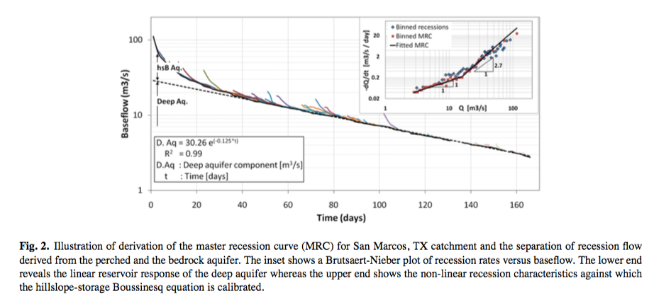
(Carrillo et al, 2011)
Separated baseflow into two components: (1) nonlinear hillslope boussinesq recession which represents near-surface perched aquifer; (2) linear recession of deep aquifer
The lower end of the MRC is used to determine linear deep GW recession
The upper end shows nonlinear hillslope recession
We want the deep GW part?
(Posavec et al, 2006) and (Posavec et al, 2010) – details; email for Visual Basic and Excel

Slide 5
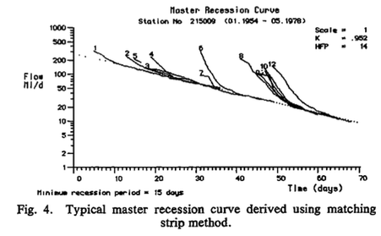
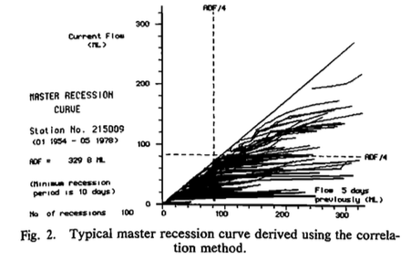
(Nathan and McMahon, 1990)
Two methods for construction the Master Recession Curve:
Correlation method (Plot discharge at one time against discharge 1 to N days later. find slope of the enveloping line, typically at ¼ of mean daily discharge)
Matching strip method: first extract recession periods, and rank in descending order. Interactively shift the master recession curve until it passes through all recessions
Correlations method
Matching strip method
These methods fail for intermittent streams
Since these find linear recessions, would we need to alter to fit power law?

Slide 6
Fixing NSE’s sensitivity to the lower tail of the pdf by comparing CDFs and FDCs:
Prediction
CDF
Numeric CDF: calculated CDF by doing cumulative sum of PDF
Analytic CDF: Used Marc’s analytic CDF equation
FDC
Analytic FDC: Calculated by using FDC = 1 – analytic CDF, interpolated to a fixed exceedance probability
Observation
CDF
calculated by cumulative sum of histogram density
FDC
calculated from 1 - CDF

Slide 7
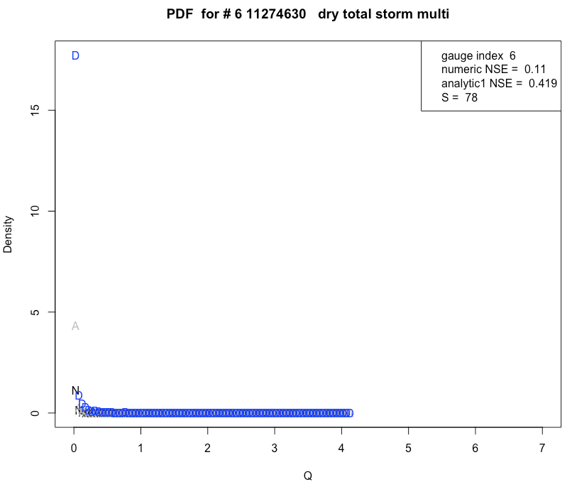
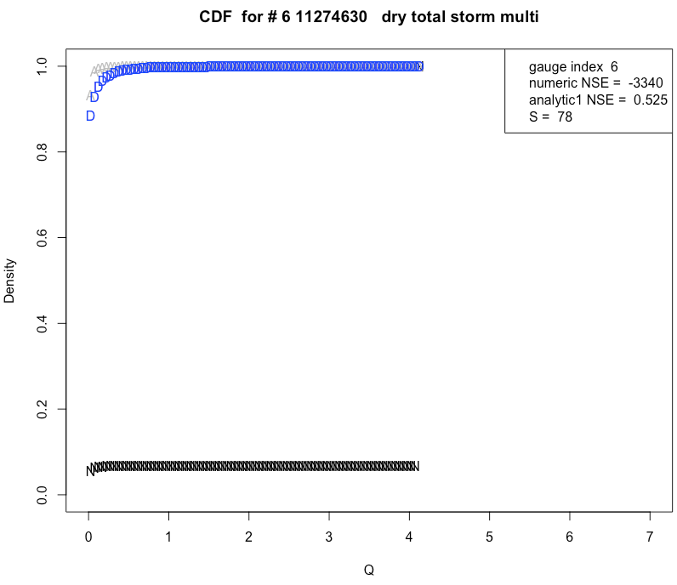
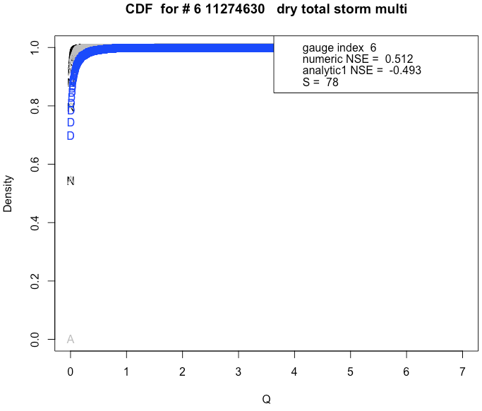
Numeric CDF (black): terrible, errors on left side of pdf are propagated
Analytic CDF (gray): better, but number of histogram breaks changes NSE significantly (as number of breaks increases, have increasing influence of tail)
Numeric CDF amplified PDF errors
n = lower
Number of breaks matters a lot for analytic CDF’s NSE
n = higher
R Code: Testing Marc Seasonally Dry v2.R

Slide 8
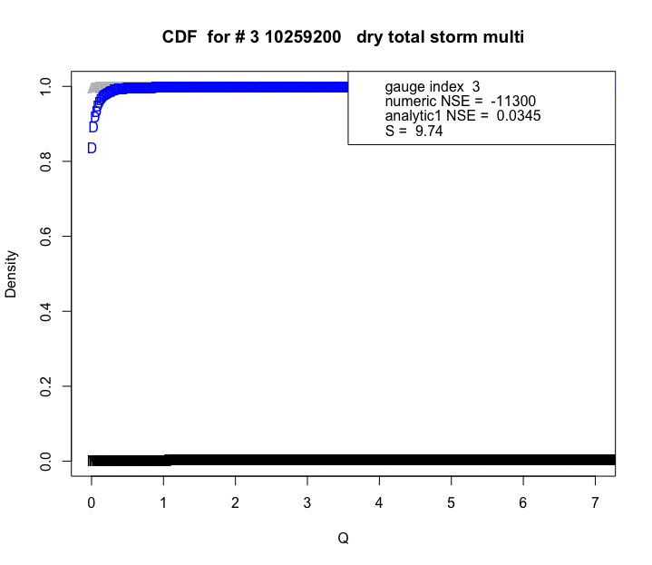
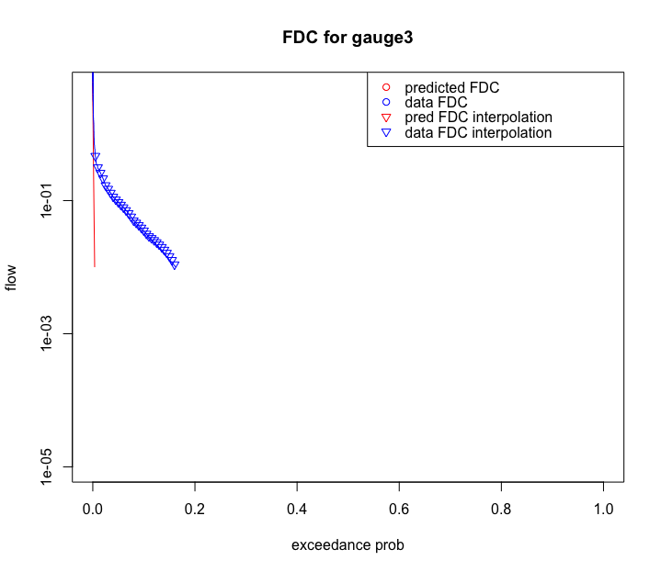
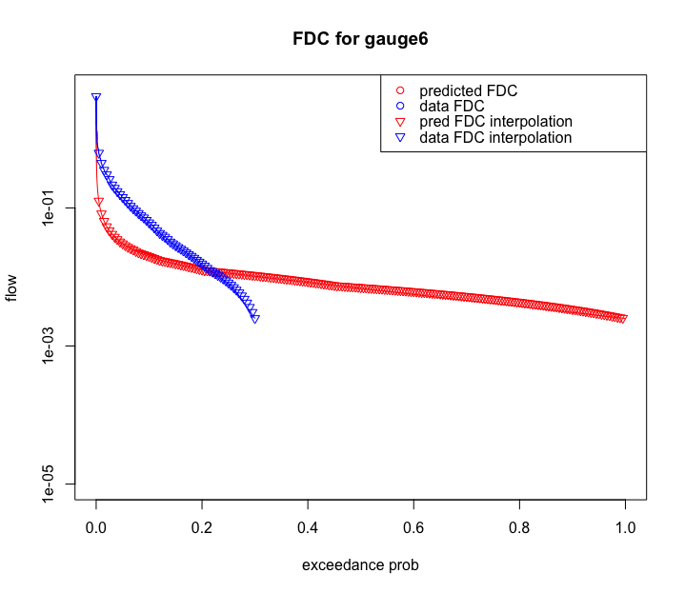
FDC is very sensitive to the lower end of the pdf, so it doesn’t solve the problem.
When analytic CDF misses the left tail, FDC can’t be found
Even when the full FDC can be found, agreement isn’t good. (Amplifies the problem of not enough resolution on the lower end?)
R Code: Testing Marc Seasonally Dry v2.R

Slide 9
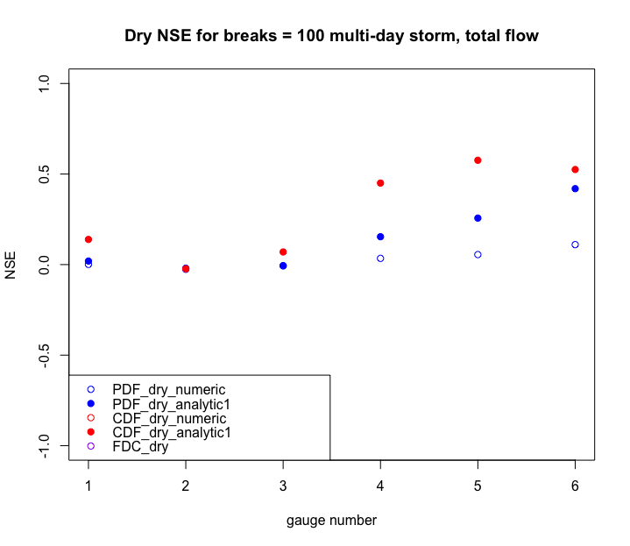
The following plot shows that overall, analytic CDF gives best performance.
However, number of breaks in histogram matters because it impacts the importance of the CDF’s left side.
Overall, can’t use FDCs or CDFs to get a more stable NSE, but analytic CDF is best
R Code: Testing Marc Seasonally Dry v2.R

Slide 11
Decide on what the NSE should be based on (PDF, CDF or FDC – calculated analytically or numerically) for the dry season
Fixing NSE’s sensitivity to the lower tail of the pdf by changing it to CDFs and FDCs:
For numeric Marc’s CDF: cumsum of numeric Marc’s pdf * dQ
For analytic1 Marc’s CDF: use FCN_findDrySeasonCDF_Marc and sapply
For data CDF: cumsum of the histogram desntiy * dQ
Note: for the two above functions, had to change order of arguments to have qd as the first argument!
For numeric data CDF: first had to calculate histogram, then convert numerically to a CDF using cumsum
In Testing Marc Seasonally Dry v2.R: calculate this CDF, FDC agreement in addition to PDF agreement. change NSE_matrix to accommodate both NSEs.
R Code: Testing Marc Seasonally Dry v2.R

Slide 12
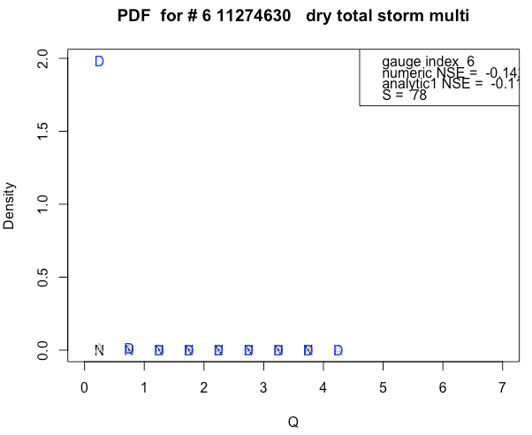
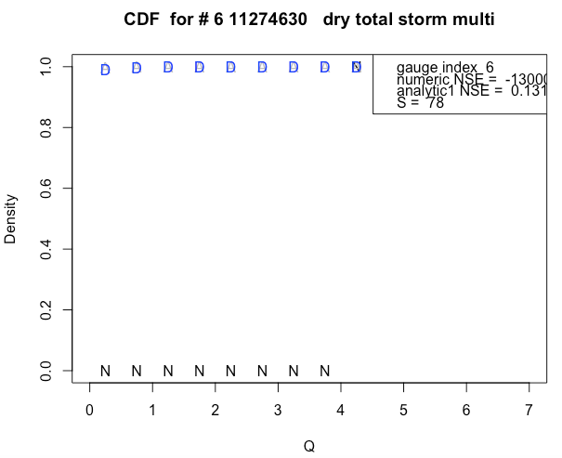
Numeric CDF actually does worse than pdf
The numerically found CDF is very very bad, because doing cumsum of pdf to find cdf will magnify errors on the left side of the distribution throughout the entire distribution, as below.
Numeric is in black; if the pdf doesn’t capture the initial spike, then numeric CDF will be wrong.
Analytic is in gray; it does much better. So do analytic CDF.
Note that the data CDF (in blue) is numerically solved from the pdf using cumsum.

Slide 13
Next, attempt looking at FDC to find NSE.
To find FDC (in Testing Marc Seasonally Dry v2.R), used analytic CDF because it does better than numeric CDF
The x axis, exceedance prob, is 1 – analytic_CDF. The y axis is flow rate. For both the data and the prediction, flow rate vector is the same. However, we want to have exceedance prob vectors to be the same. Therefore, used approx() to interpolate the flow rate vector for both the data and the prediction.
For now, skipped finding FDC of wet season
When the CDF starts very near 1, resulting FDC = 1-CDF can capture only a very very tiny amount of the lowest exceedance probabilities; hard to capture a good view of what FDC looks like in order to compare predicted FDC to data FDC.
Note that the SAME pdf issues (not getting the left hand side correct) cause AMPLIFIED issues in CDF and FDC.
Taking the log(FDC) in order to calculate NSE actually doesn’t help much; NSE stays very negative regardless.
R Code: Testing Marc Seasonally Dry v2.R

Slide 14
When analytic CDF misses the left tail, FDC can’t really be found
For the best results, choose analytic CDF as the mode of comparison.
This red predicted FDC line stretches so far because analytic CDF starts from zero.
R Code: Testing Marc Seasonally Dry v2.R

Slide 15
The following plot shows that overall, analytic CDF gives best performance. However, number of breaks in histogram matters. (Why is this?)
Analytic CDF has consistently better NSE than all the others:
R Code: Testing Marc Seasonally Dry v2.R

Slide 16
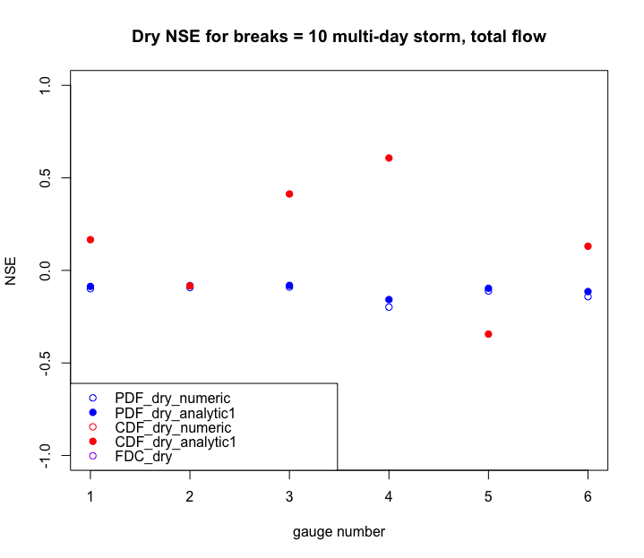
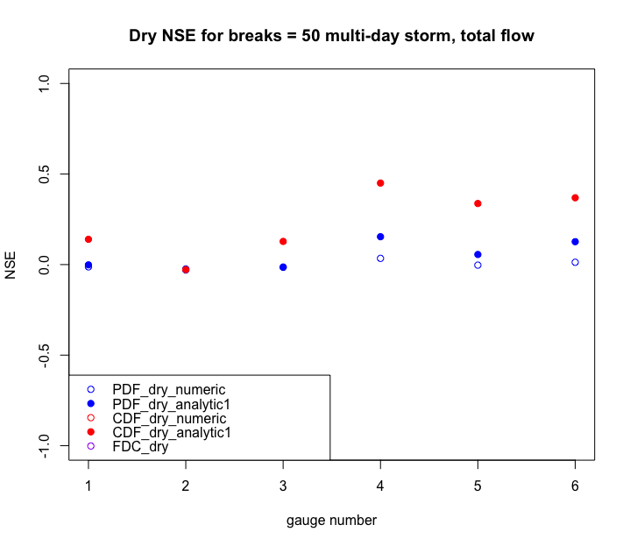
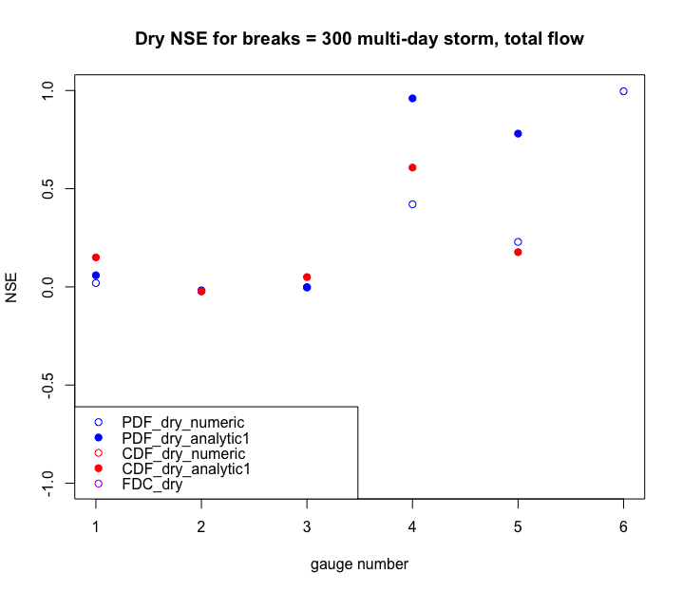
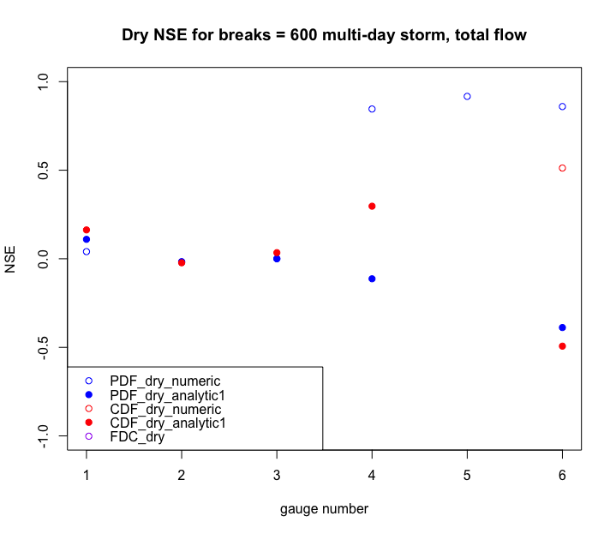
Why does NSE for analytic CDF depend so heavily on number of breaks?
(perhaps due to the increasing presence of the lower left tail of CDF as number of breaks increases)
R Code: Testing Marc Seasonally Dry v2.R

